Slide 1



CH303 : PROCESS CONTROL
PROJECT TOPIC- CSTR IN SERIES
Kartik
ENTRY NO-2023CHB1068
SUBMITTED TO - DR. JAYRAM VALLURU

Slide 2
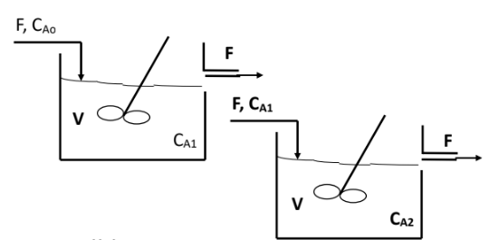
PROCESS DIAGRAM:
CA1 , CA2 : CONTROL VARIABLES
CA0 : MANIPULATED VARAIBLES
F: DISTURBANCE VARAIBLE

Slide 3

DYNAMIC MODEL EQUATION :
04/10
COMPONENT MATERIAL BALANCE:
Given Process parameters :
CA1(initial guess) = 0.236 Mol/m3
V(volume of the reactor) = 2.1 m3
CA2(Initial guess) = 0.05 Mol.m3
F (Feed Flow rate) = 0.085 m3/min
CA0(Inlet Concentration) = 0.925 Mol/m3
K = 0.040 min-1

Slide 4

Process Objectives:
Empirical Model Identification of FOPTD Models.
Steady State and Dynamic Simulation of Non-Linear Model.
4 . Feedback Controller design
Linearization and Simulation of Linear State Space Model and Stability Analysis
Closed loop stability

Slide 5
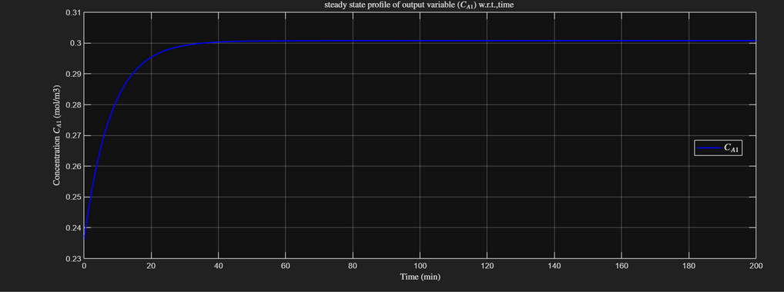
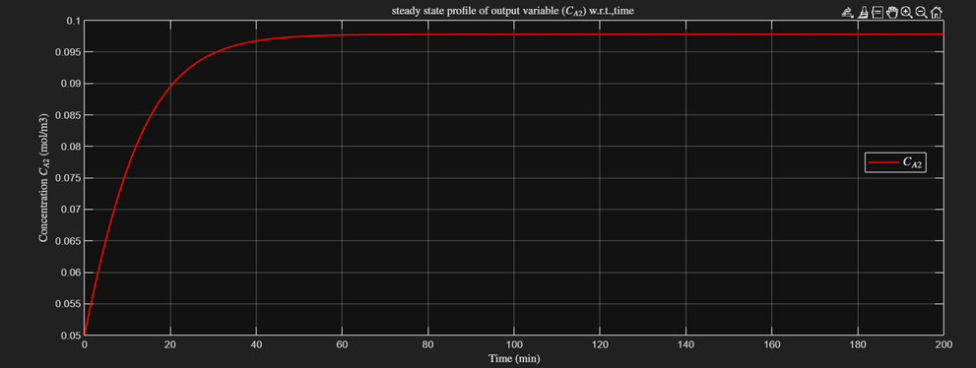
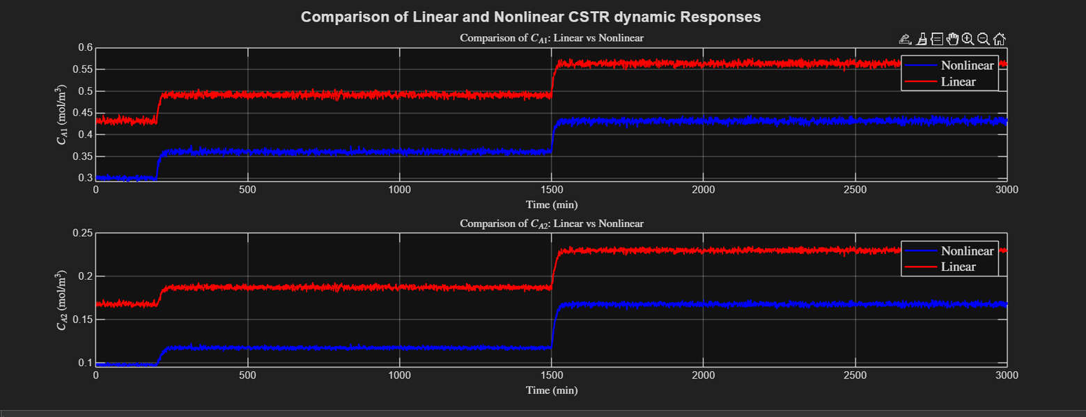
06/10
OPEN LOOP SIMULATIONS:
SIMULATION RESULTS OF LINEAR AND NON LINEAR MODEL

Slide 6
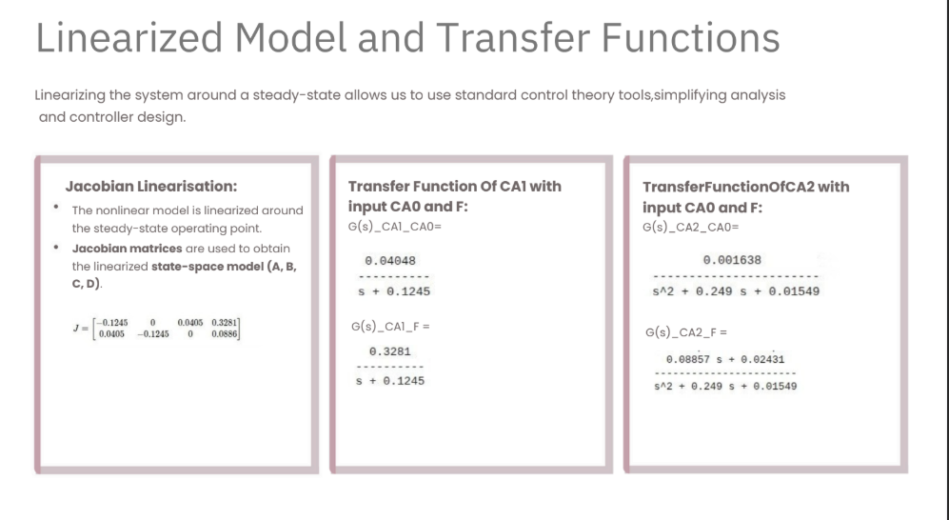
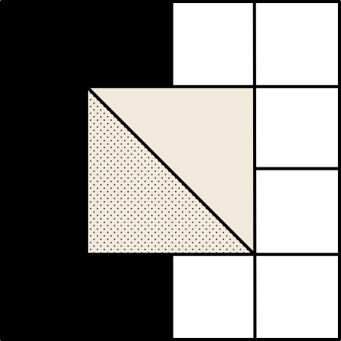
07/10

Slide 7
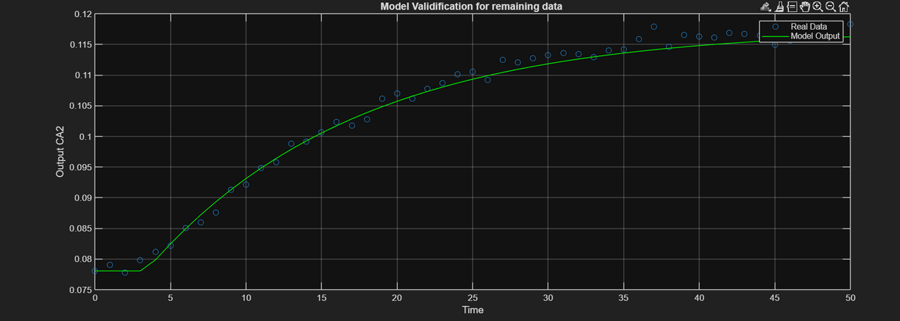
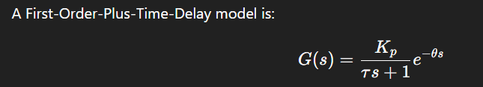
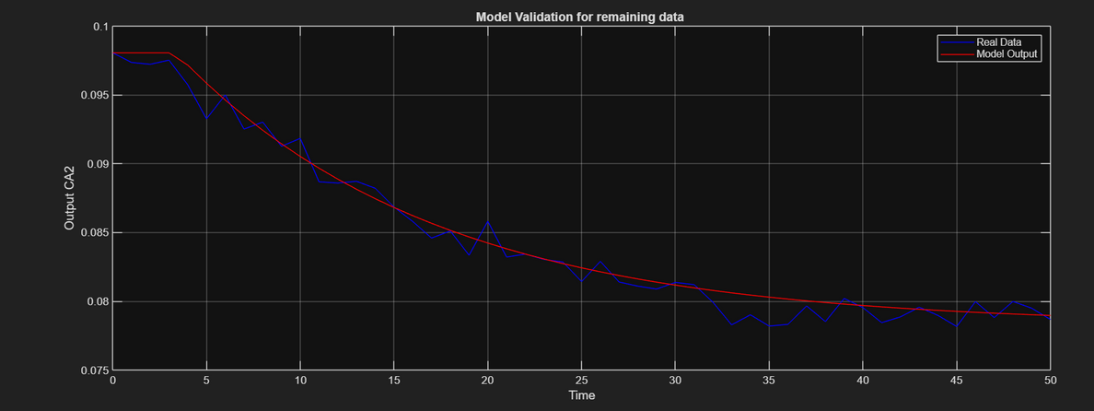
Empirical Model Identification of FOPTD Models:
08/10
Nonlinear Regression using lsqcurvefit to calculate FOPTD parameters on some part of data and validation for test data
FOPTD PARAMETERS RESULT:
K p = 0.1069
TauP = 13.8375
Theta(delay) = 3.3592
True_parameters from transfer function model
Kp = 0.1057
TauP = 8.0346

Slide 8
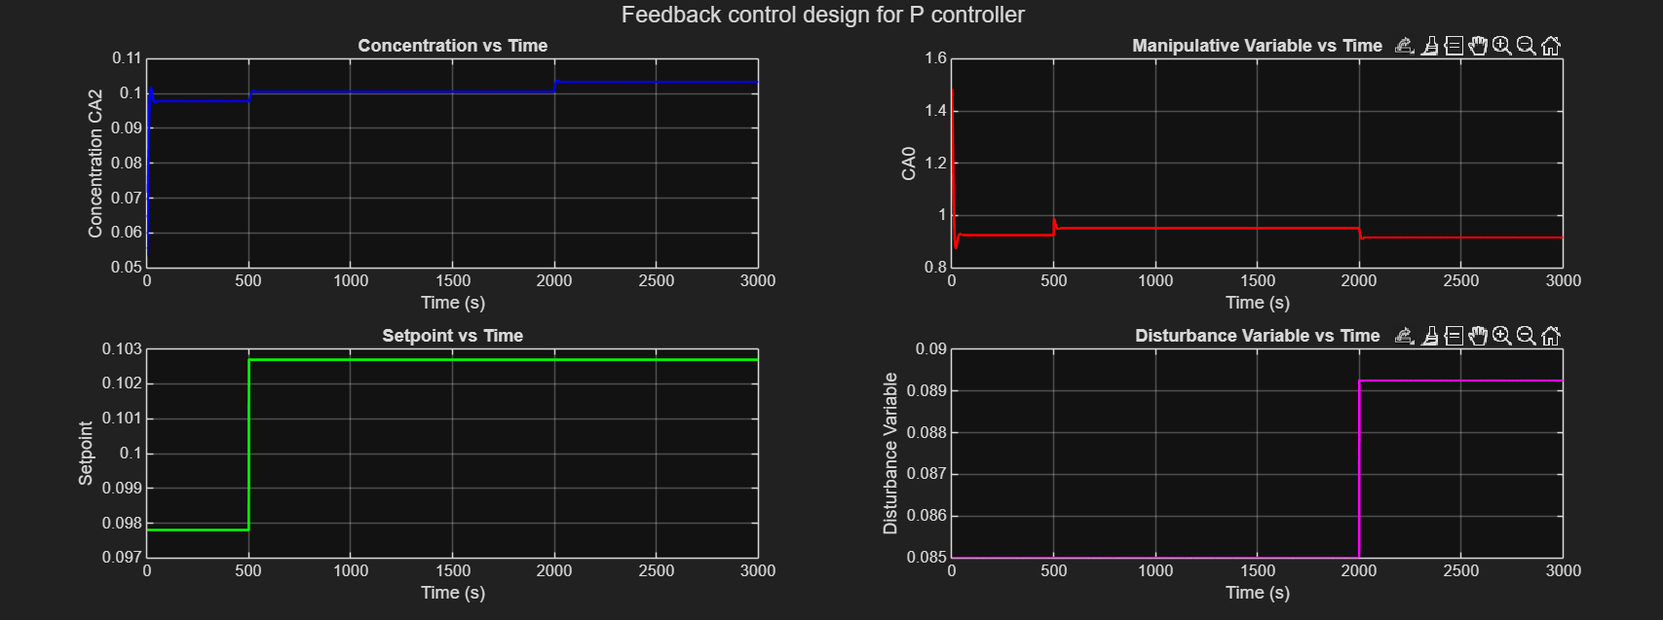
Feedback Controller design
09/10
FOR P CONTROLLER :
Comparison of Setpoint vs-controlled variable (CA2) of plant w.r.t number of samples (i.e., sampling instants) shown
P controller have offset in the output response and also slow response , so generally not preferrable
Controller Output :
P(t) = P_ss + Kc * error(t)

Slide 9
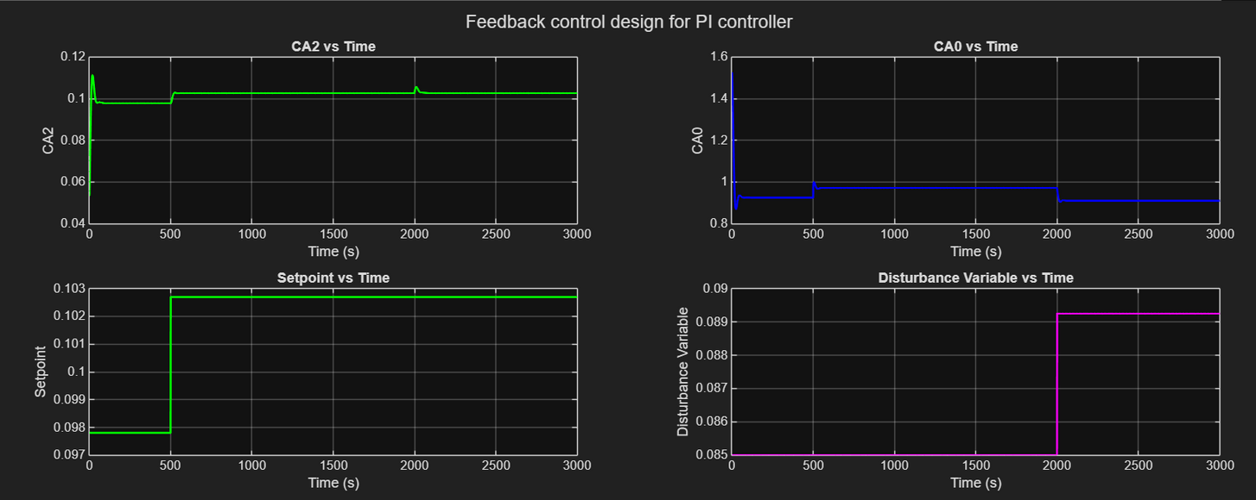
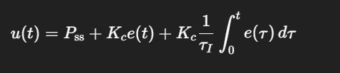
Feedback Controller design
09/10
FOR PI CONTROLLER :
Comparison of Setpoint vs-controlled variable (CA2) of plant w.r.t number of samples (i.e., sampling instants) shown
PI controller does not have offset in the output response and also fast response as compared to P controller.
Design Equation PI controller

Slide 10
CLOSED LOOP STABILITY :
10/10
Routh–Hurwitz Condition :
Ensures stability by checking signs of first-column.
Gives stable range of Kc​.
All poles remain in left-alf plane
From Closed loop stability analysis , we get the condition of Kc for Proportional Controller such that
1 + Kp *Kc > 0 or Kc > -9.35480
Kc should be positive for physical systems.

Slide 11
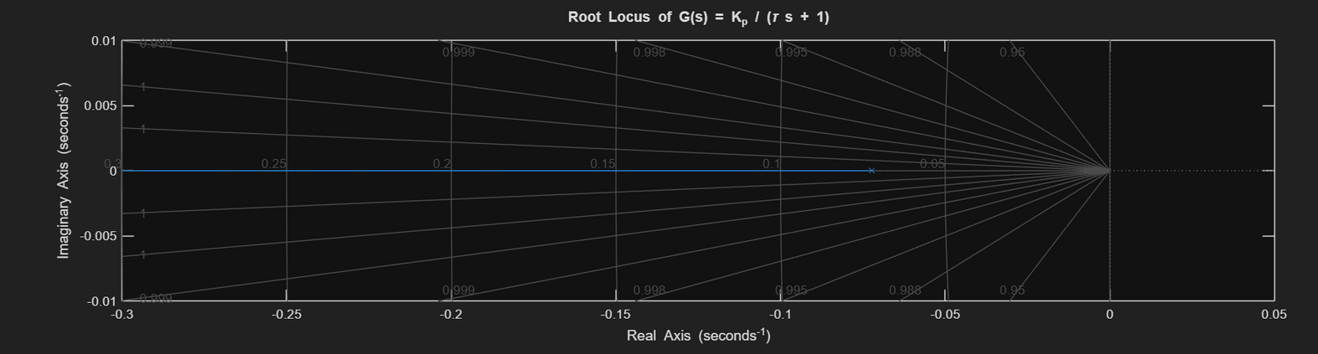
ROOT LOCUS DOAGRAM :
Root Locus shows how the closed-loop poles of a system move in the s-plane as the controller gain Kc​ varies from 0 to ∞.
The pole locations determine stability, speed of response, damping, and oscillatory behavior.
If poles stay in the left half-plane, the system is stable.
When poles cross into the right half-plane, the system becomes unstable.
System has one real pole at
s =- 1/TauP
Pole remains in left-half plane → system always stable.

Slide 12
THANK YOU!

